Slide 1

HUAWEI Health Obtain User Behaviour and Health data effortlessly

Slide 2

Hello!
I am Anil Ghimire
Developer Technical Support Engineer (DTSE)
You can find me at https://www.linkedin.com/in/anil-ghimire/

Slide 3
“To keep the body in good health is duty; otherwise we shall not be able to keep the mind strong and clear.”
-Buddha

Slide 4
Background

Slide 5
Contents
mHealth and Health APIs
HUAWEI Health kit Overview
Awareness Kit Overview
Practical Use Cases
Sample Codes

Slide 6
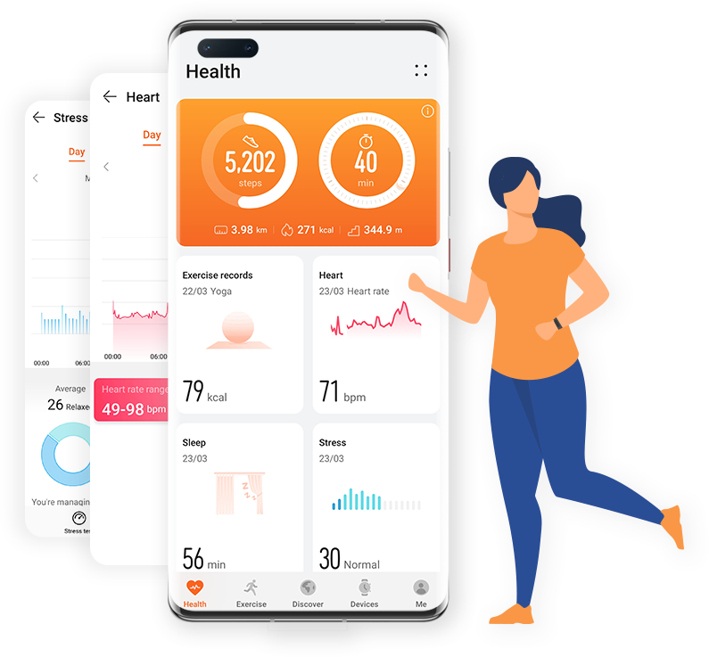




mHealth

Slide 7
mHealth
Monotiring and sharing health info using smart devices and health tracking apps.
Smartphones are hub for additional sensors.
Smart watches are best additional sensors.
Wearable sensors has endless possibilities.
Notes:
Paragraph

Slide 8
Health APIs
Fitness trackers and wearables gather enormous amount of data.
Need for a platform to effectively use the data.
Industry giants Google, Apple, Samsung, Huawei has platforms to manage the health data.

Slide 9

HUAWEI Health Kit

Slide 10
Overview
HUAWEI Health kit connects the hardware devices and ecosystem apps to provide
Consumers: Health care, workout guidance and ultimate service experience.
Developers: a open data platform and API capabilities to upload and use data.

Slide 11
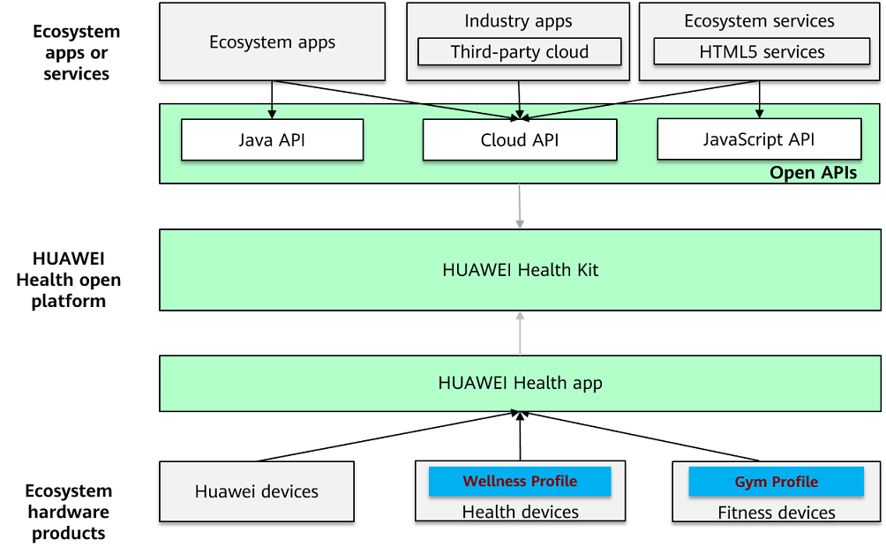
Overview

Slide 12
Security and Privacy
Data Security Management
User Authorization management
Privacy Compliance Management

Slide 13
Basic Concept
Data Type
Health Kit provides standard defination of data types for easy understanding of the sampling data.
Data Controller
It is used to represent the raw data collection source, a unique identifier is generated when data collector is created.
Data Sampling Point
Sample of specific type of data collected by specific Data collector at specific moment.
Sampling Dataset
Is a container for storing sampling points that come from same Data Controller.
Activity Records
It records the user activity details within a period of time, consisting of the activity type, app information, time period, etc.
Health Records
It records the user health details within a period of time, health record type, data controller, etc.

Slide 14
Basic Health Capabilities
Basic health capabilities provides atomic data openness using which the app can add, delete, modify, and query.
Scopes
Personal Data: Height, weight.
Health data: Sleep, Heart rate, Nutrition, Stress.
Fitness Data: Step, Distance, Speed, Calories, Strength, Activity.
Restricted Data: Blood Glucose, Blood Pressure, Oxygen Saturation.
Activity Record

Slide 15
Extended Health Capabilities
With Extended health Capability, you can obtain health data and activity data from the Huawei Health app or write your data to the app.
Open Data types
Health data: Sleep, Heart Rate, Body fat.
Restricted Data type: Blood Oxygen, Body temperature.
Health Solution: Gender, DOB, height, weight, Real-time heart rate.
Activity Solution: Step, distance, calories, intensity, walking, running, cycling, Real-time activity data.
Device Information: Device name, device model and more.

Slide 16

Awareness Kit

Slide 17
Overview
Capture
Obtains user conditions, such as the time, location, weather, behavior (walking/running/driving), headset status (plugged or not), beacons (registered or connected), light intensity, and car Bluetooth status (connected or not).
Barrier
Notifies your app when a user meets preset conditions (such as entry into an area and length of stay)

Slide 18
Awareness Capabilities
Headset: Connected / Disconnected.
Behavior: Staying Still, Walking, Running, Cycling or Driving.
Location: Fused Location, Geofence.
Time: Working day, Holiday, Weekend, Morning, Afternoon, Night, Sunrise and Sunset.
Weather: Temperature, Humidity, Wind direction, wind power.

Slide 19
Development Process
Preparation
ApplyHuawei ID
Apply Health Kit*
Development
Integrate HMS Core
Develop app using Android studio / DevEco Studio.
Specific about HOS
Verification
Submit for release verification of the health service.*
Release
Submit app to review for release.
Note:
* Only for Health Kit

Slide 20
Development Environment
Kits |  | OS support | HMS Core / SDK version
Health Kit | Basic Capabilities | Android 6.0+ EMUI 5.0+ | HMS core: 4.2.0.300+ SDK: 6.4.0.301 Huawei Health app: 11.0.0.512+
 | Extended Capabilities | EMUI 6.0+ | HMS core: 5.1.0.300+ SDK: 6.3.0.300 Huawei Health app: 11.0.0.512+
Awareness Kit | Time, Audio, Ambient, Screen, Wi-Fi, Weather | Android 7.0+ EMUI 5.0+ | HMS core: 4.0.2.300+
 | Dark mode | Android 10.0+ EMUI 10.0+
 | App, Location, Beacon | EMUI 5.0+

Slide 21
Development Platforms
Platforms | OS support
Java/ Kotlin | Android
REST APIs | Web Services
JavaScript APIs | HarmonyOS
Reactive Native, Cordova, Xamarin, Flutter | Only Basic Health Capabilities
Notes:
About the platforms supported for Health Kit
Awareness Kit
What version of HMS core and Health Kit, Awareness Kit.
What kinds of devices we support.

Slide 22
Practical Use cases And Sample Codes

Slide 23
Use-cases: Links
Step Count of the day: https://developer.huawei.com/consumer/en/doc/development/HMSCore-Guides/steps-delta-scene-0000001050822049
Running Activity Records: https://developer.huawei.com/consumer/en/doc/development/HMSCore-Guides/write-sports-recording-scene-0000001050782024
Reading real-time step count: https://developer.huawei.com/consumer/en/doc/development/HMSCore-Guides/real-time-steps-data-0000001054876912
Reading Sleep: https://developer.huawei.com/consumer/en/doc/development/HMSCore-Guides/read-client-sleep-scene-0000001091427304
Heart rate Alert: https://developer.huawei.com/consumer/en/doc/development/HMSCore-Guides/client-basketball-write-scene-0000001144924115
Querying Daily Activities: https://developer.huawei.com/consumer/en/doc/development/HMSCore-Guides/extended-querying-dailyactivity-0000001053253403
Querying Health Data: https://developer.huawei.com/consumer/en/doc/development/HMSCore-Guides/extended-querying-singleworkout-record-0000001053333367

Slide 24
Sample Codes
Sample Codes | Use Cases
Request Authorization from User | Needed to get authorization from app user.
Data Controller; Read and Write Data | Read and Write data from Huawei Health Kit.
Activity Record Controller | Perform Activity data in Health Kit
Health Record | Perform Health Data in Health Kit
Subscribing Health Data | Subscribing the health data
Awareness Kit | Getting User behavior

Slide 25
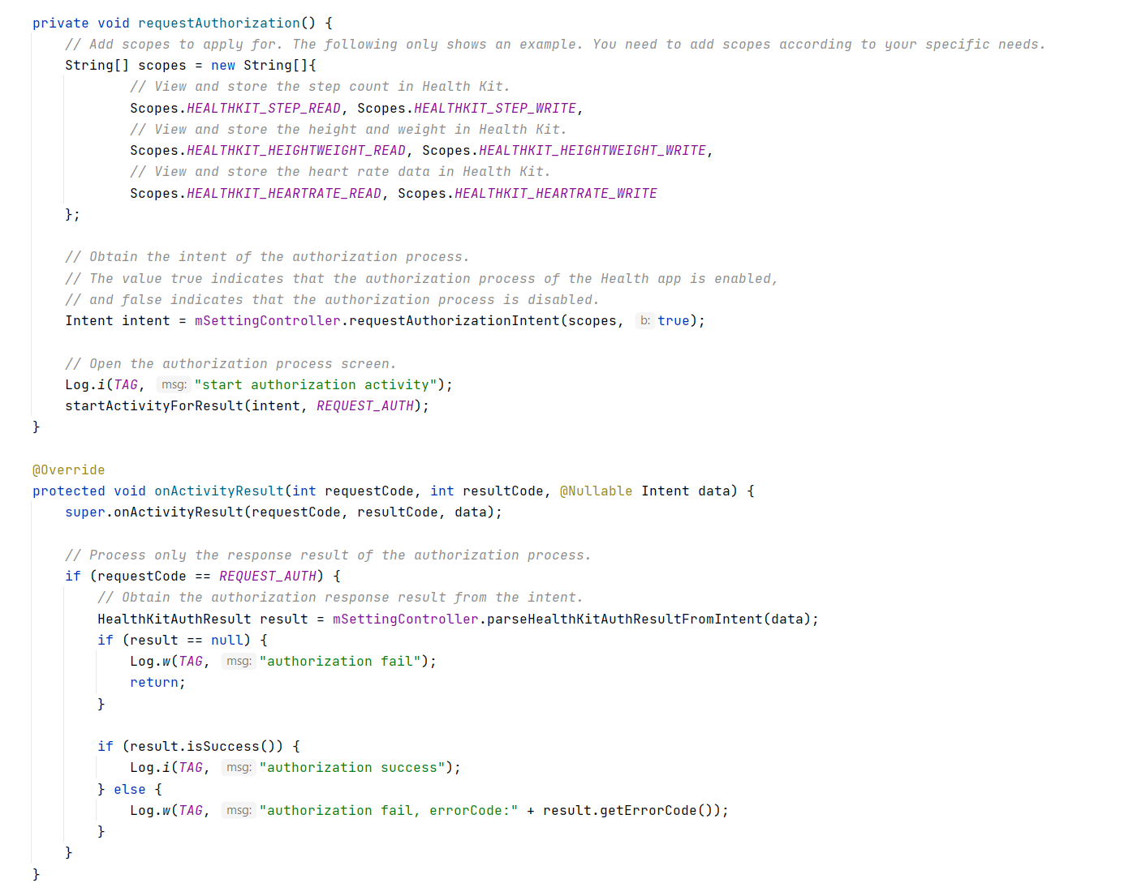
Request Authorization from User

Slide 26
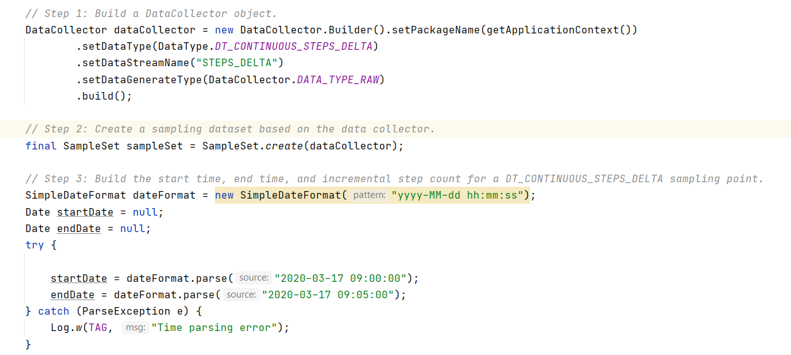
Data Collector: Initialize

Slide 27
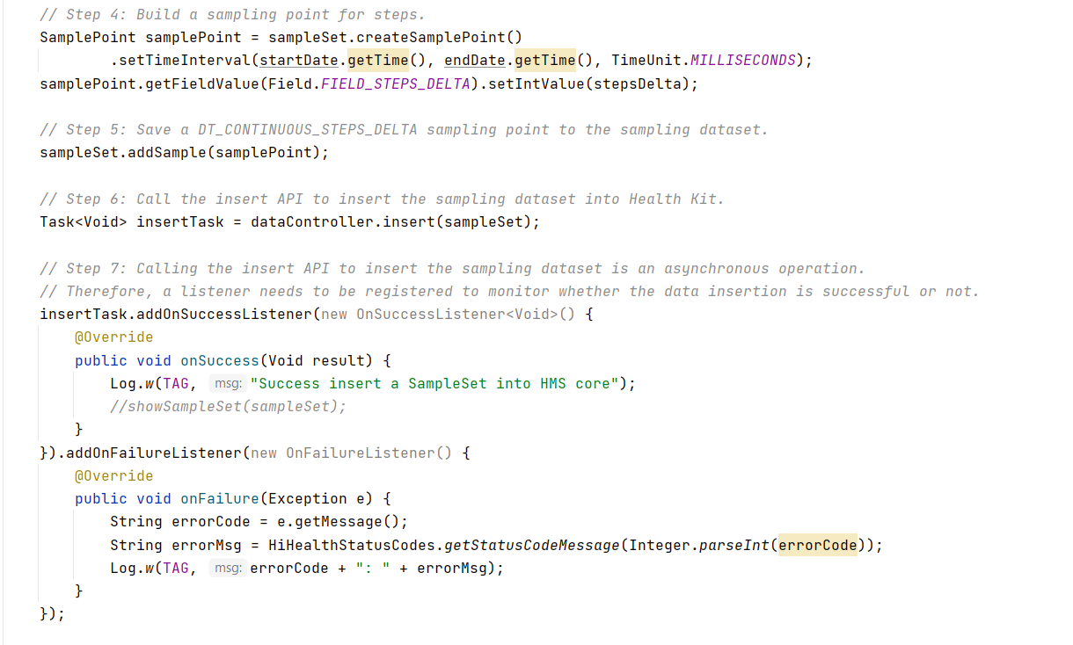
Data Controller : insert data

Slide 28
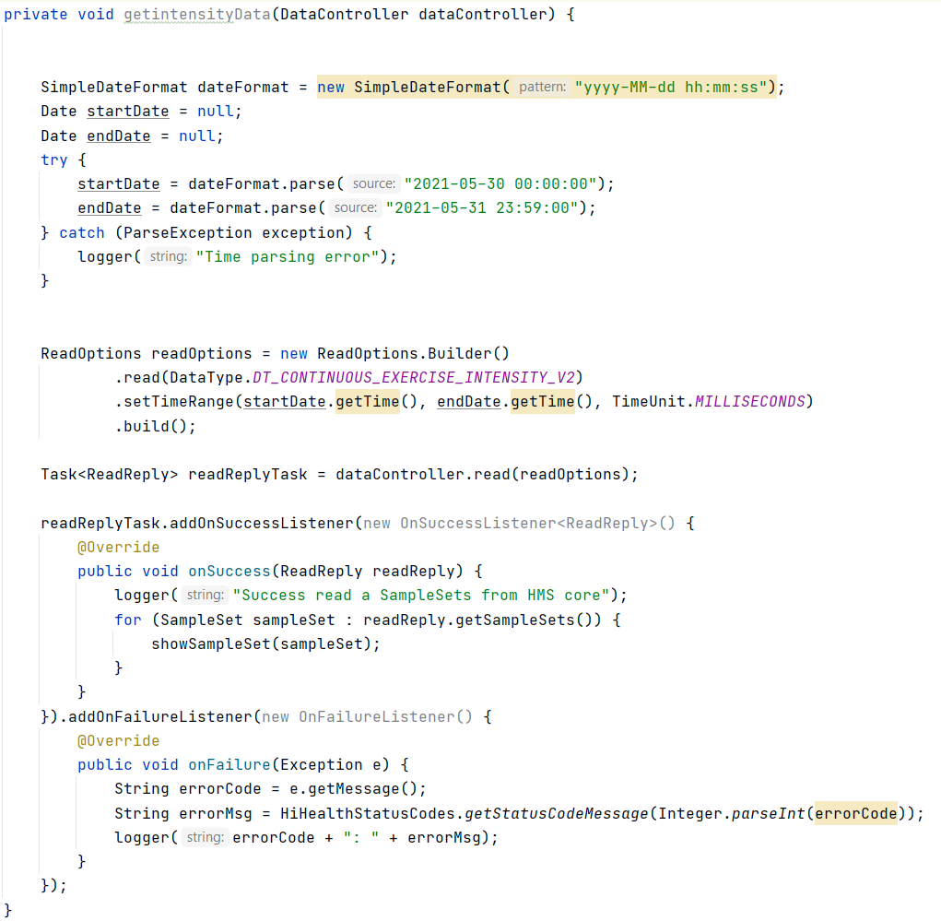
Data Controller: Read Data

Slide 29
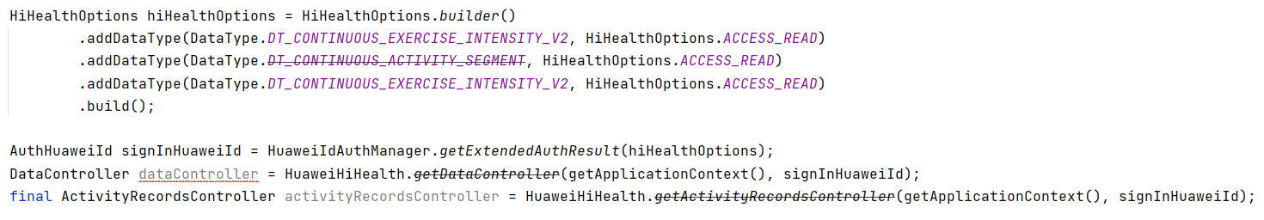
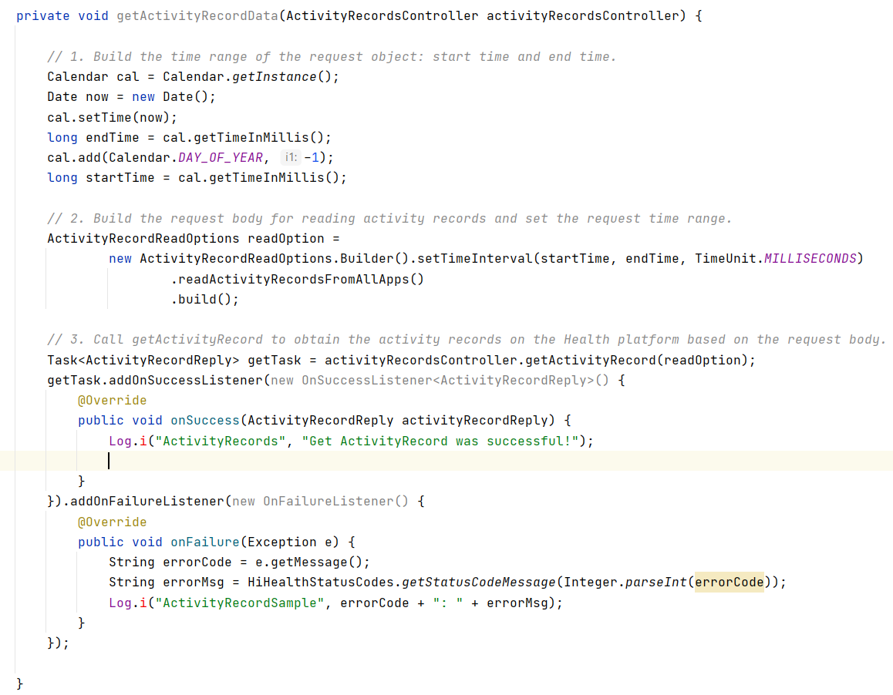
Activity Record

Slide 30
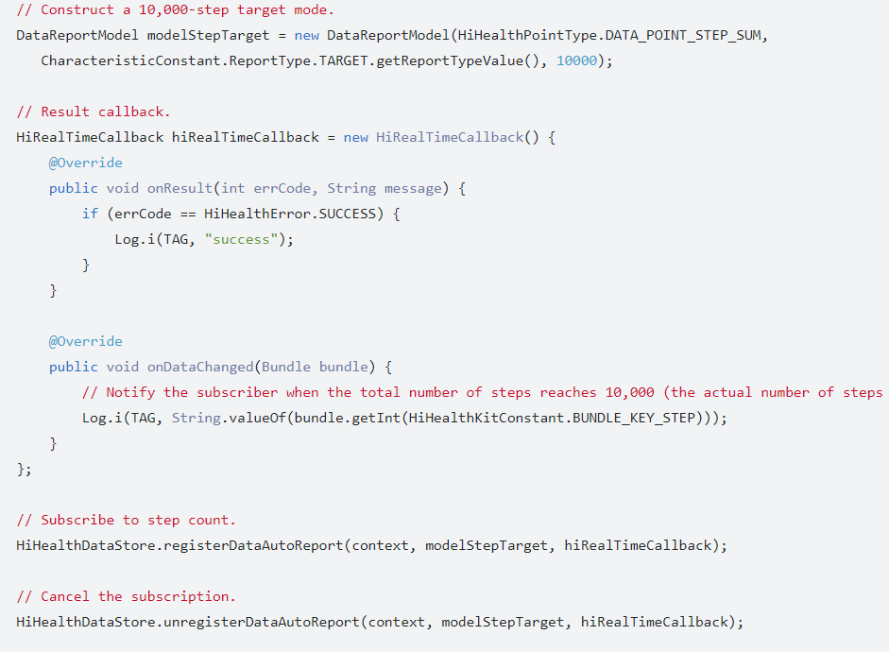
Subscribing Health Data

Slide 31
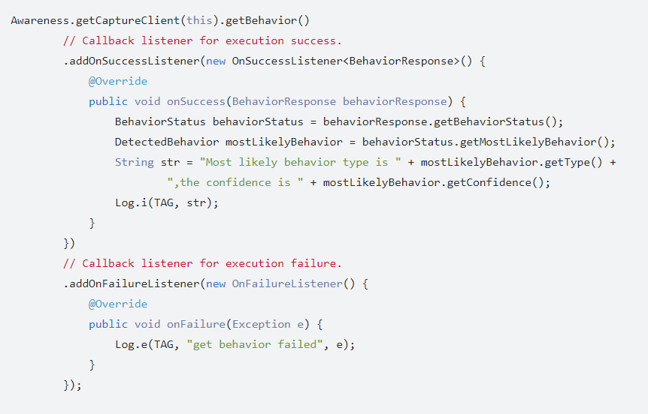
Awareness Kit

Slide 32
Appendix
Huawei Health Kit: https://developer.huawei.com/consumer/en/doc/development/HMSCore-Guides/health-introduce-0000001053684429
Awareness Kit: https://developer.huawei.com/consumer/en/doc/development/HMSCore-Guides/service-introduction-0000001050031140
Huawei Training Videos: https://developer.huawei.com/consumer/en/training/result?type1=101590551013513007&searchTxt=Huawei%20health
Huawei Health REST APIs: https://developer.huawei.com/consumer/en/doc/development/HMSCore-Guides/overview-restful-api-0000001050071695
Code Labs: https://developer.huawei.com/consumer/en/codelabsPortal/carddetails/MyHealth

Slide 33
Thanks!
Any questions?
You can mail me at: anil.ghimire@huawei.com

